Slide 1

Leadership Skills for the Modern Workplace
Cultivating Influence and Impact

Slide 2

I build and lead high performing sales teams.
I help organisations choose the best solution that speaks to their enterprise needs.
I enjoy sharing knowledge and helping people see their potential and the opportunities available
Hannatu
Kasim Adegboyega

Slide 3

Agenda
A leader is…
Demystifying leadership
The question??
The lessons
A great leader is….
What's the point?

Slide 4

A leader is someone who inspires passion and motivation in followers
A leader is someone with a vision and the path to realizing it
A leader is someone who ensures their team has support and tools to achieve their goals

Slide 5

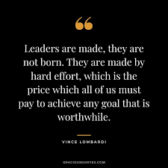
Demystifying Leadership

Slide 6
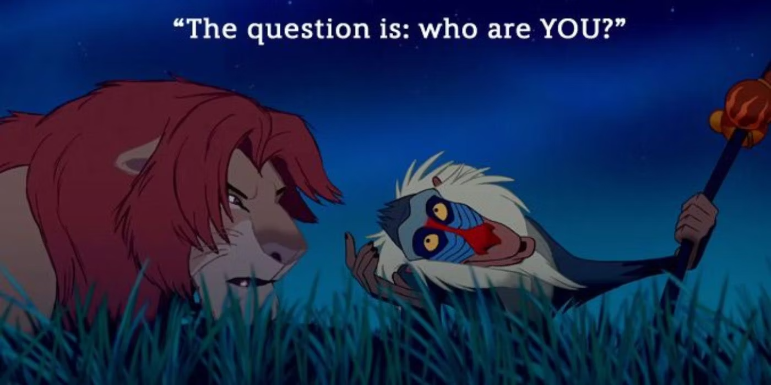

Slide 7


Slide 8
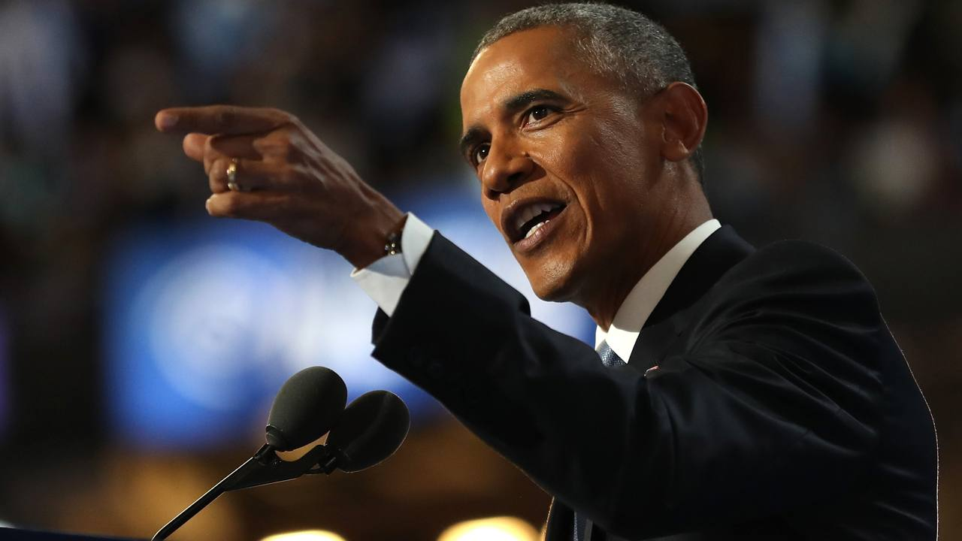
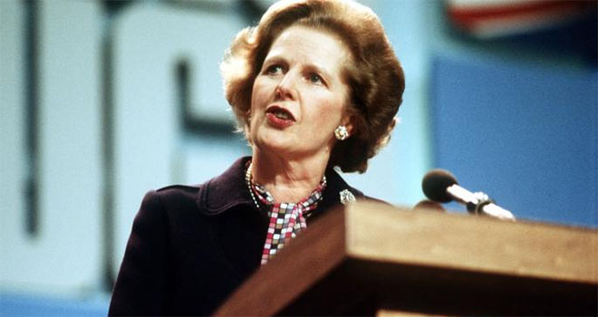
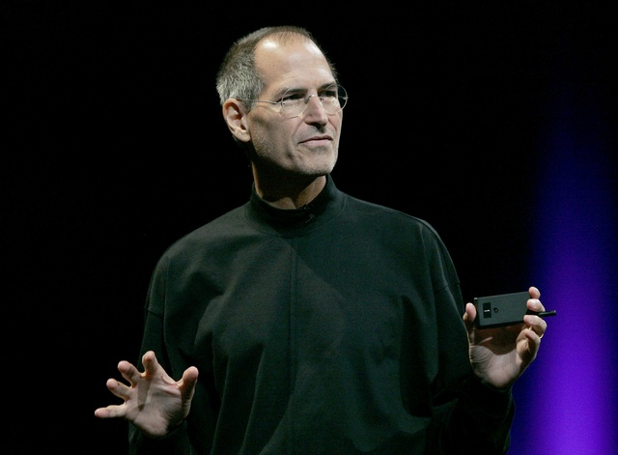
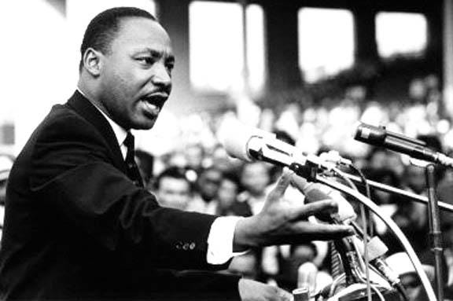
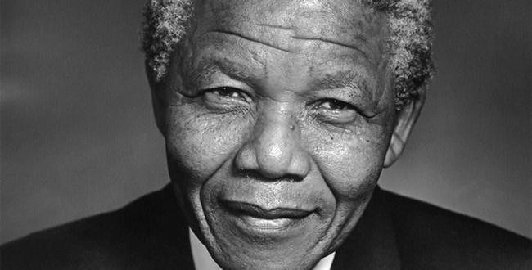
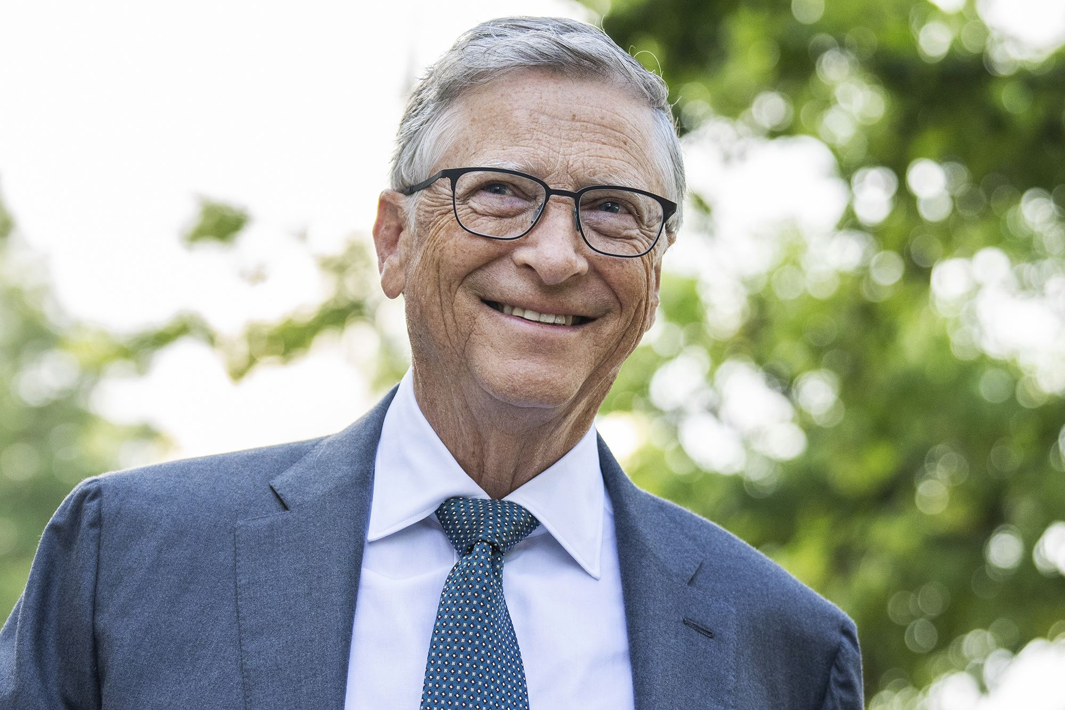
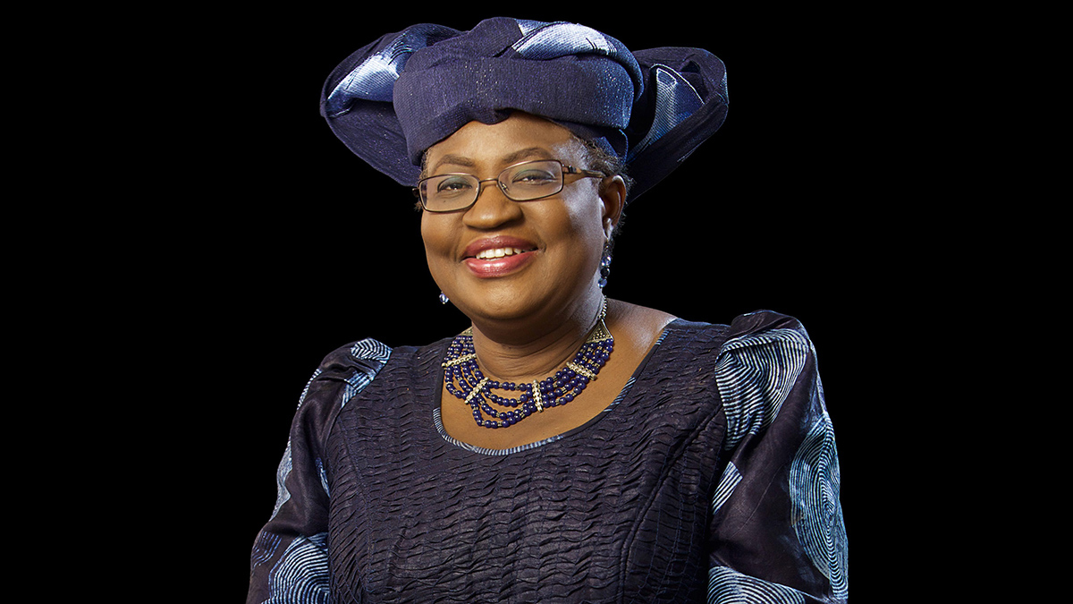
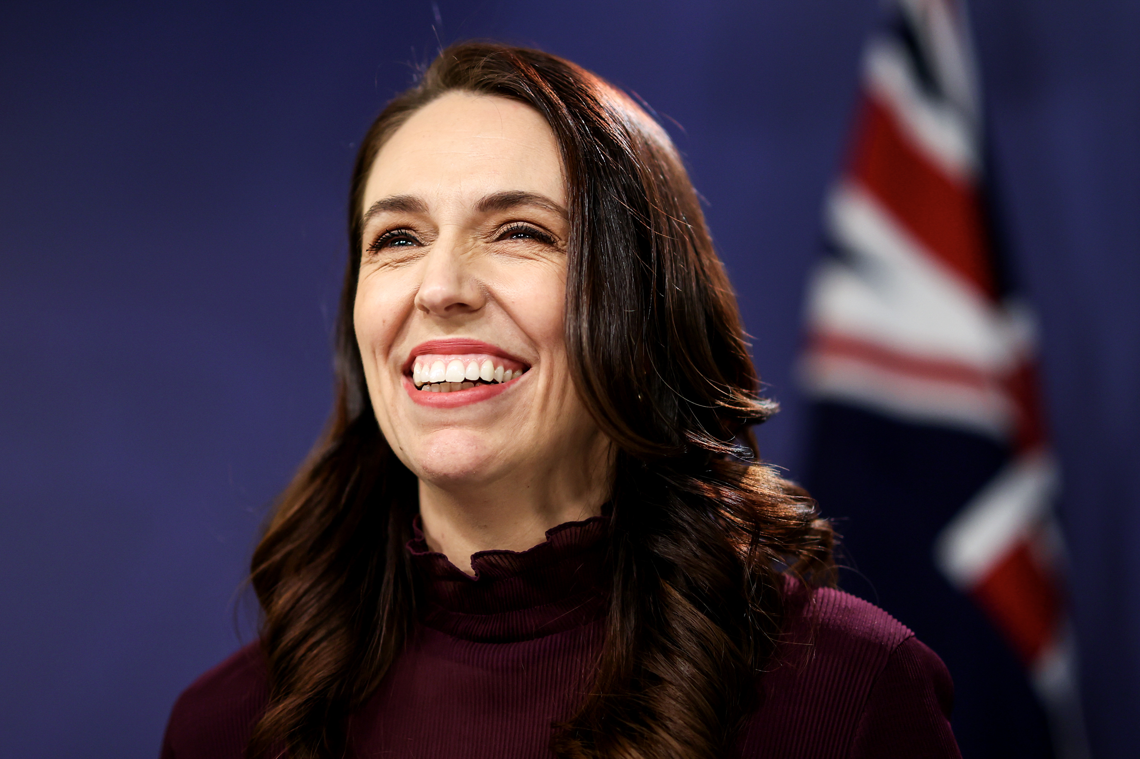
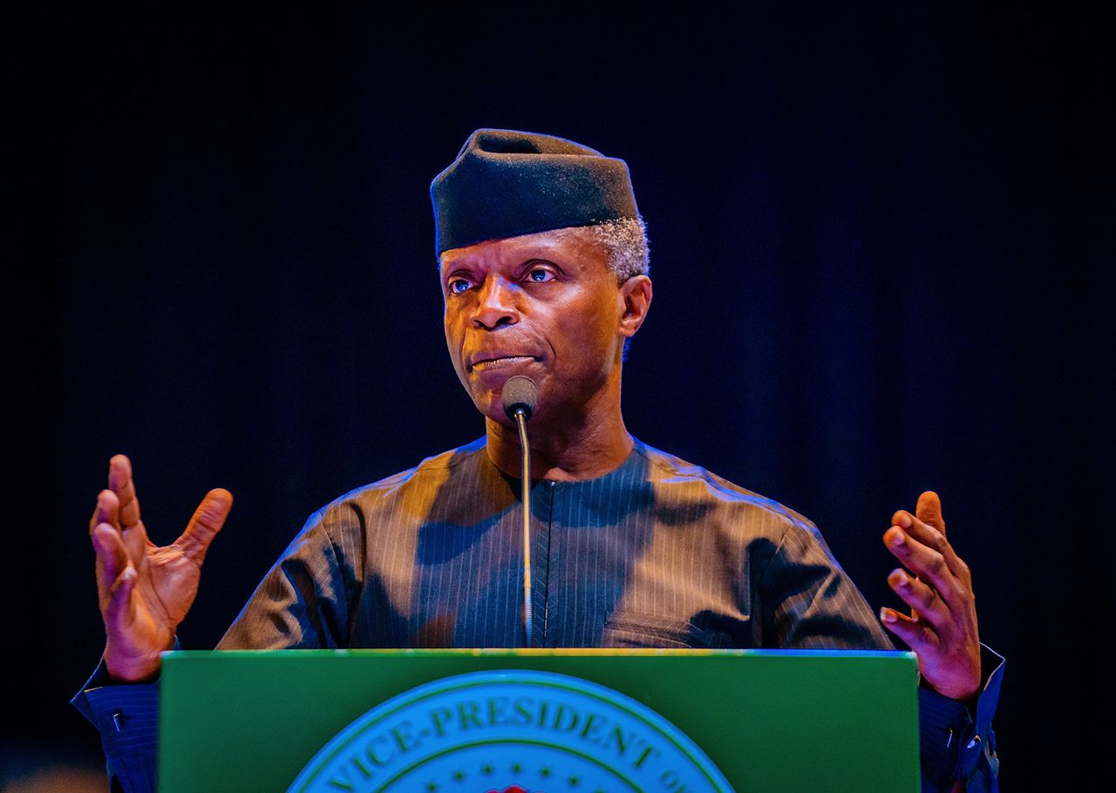
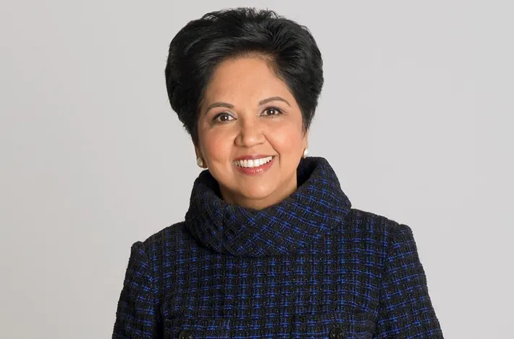
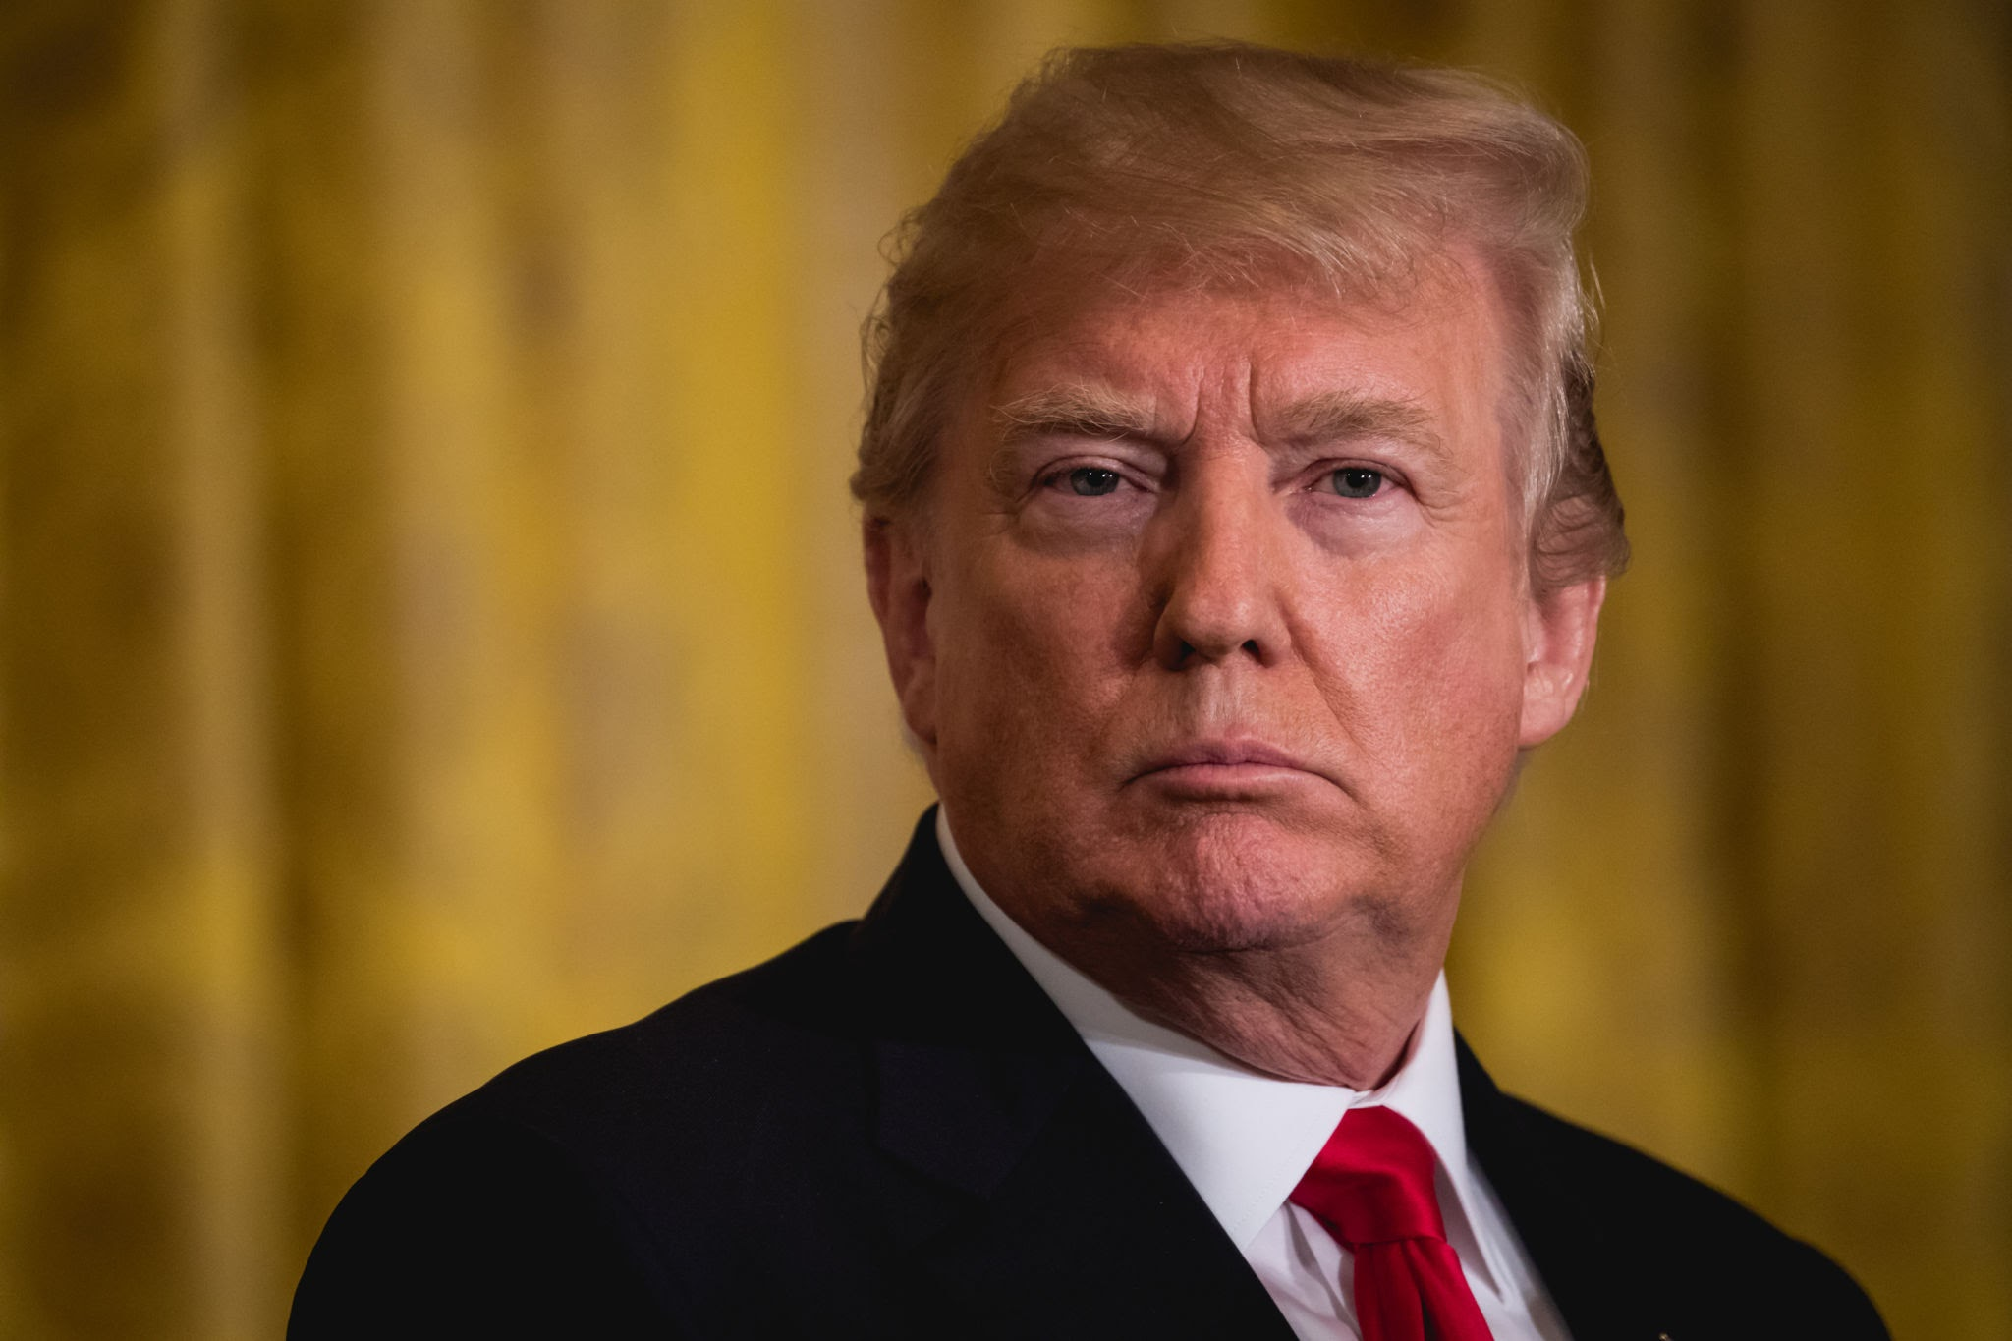
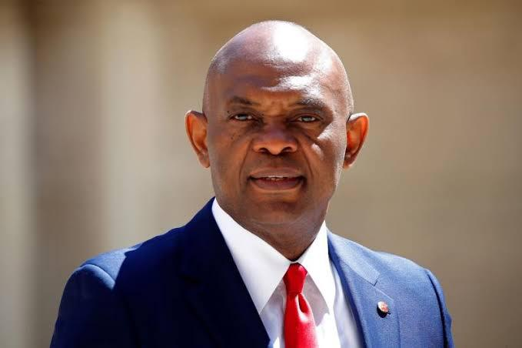
What can we learn
from them?

Slide 9







A great leader is …
01
Collaborator & Team Builder
You foster internal & external relationships and make your team feel valued, respected, and supported
Emotionally Intelligent
You understand and manage your emotions. You can build strong relationships and resolve conflicts
06
02
Strategic Thinker
You must be able to think long-term while also addressing immediate challenges
Adaptable
You must be flexible and nimble. Embrace change quickly lead your team through transitions effectively
05
03
Effective Communicator
You should be able to articulate your vision, provide constructive feedback, and actively listen to your teams' perspectives.
Empowering
You delegate tasks, provide resources and support. You give visibility
04

Slide 10
A great leader is also …
07
Ethical Leader
You work with integrity & transparency. You lead by example and uphold the values and principles of the business
Decision-Maker
You must be able to make difficult decisions, along with informed and timely choices
12
08
Resilient
You will face challenges and setbacks. How do you bounce back from failures, learn from mistakes, and maintain a positive attitude to inspire their teams during tough times.
Continuously Learning & Developing
You have to seek out opportunities to expand your knowledge and skills. Part of learning is your attitude
11
09
Inspirational Motivator
You ignite passion and enthusiasm. You encourage your team to surpass expectations
Empathetic
You can understand and relate to the emotions and perspectives of your team members.
10

Slide 11

PS... You dress well, you network and you have a great attitude

Slide 12


Slide 13


Slide 14


